Slide 1

Team Details
Team name: SRK
Team leader name: Kiran santhosh
Problem Statement: Smart decibel traffic signal

Slide 2

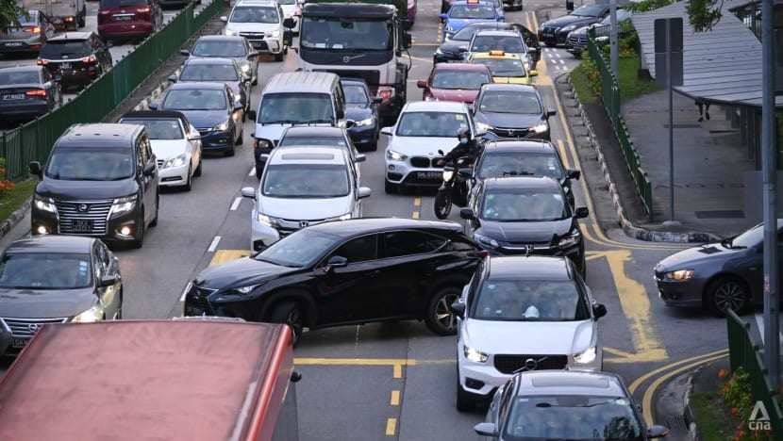
Brief about your solution and problem statement addressing
Traffic signal countdown < 5 seconds triggers impatience
Drivers honk excessively, creating noise pollution
Aggressive behavior increases accidents and stress
No mechanism to discourage impatient behavior

Slide 3
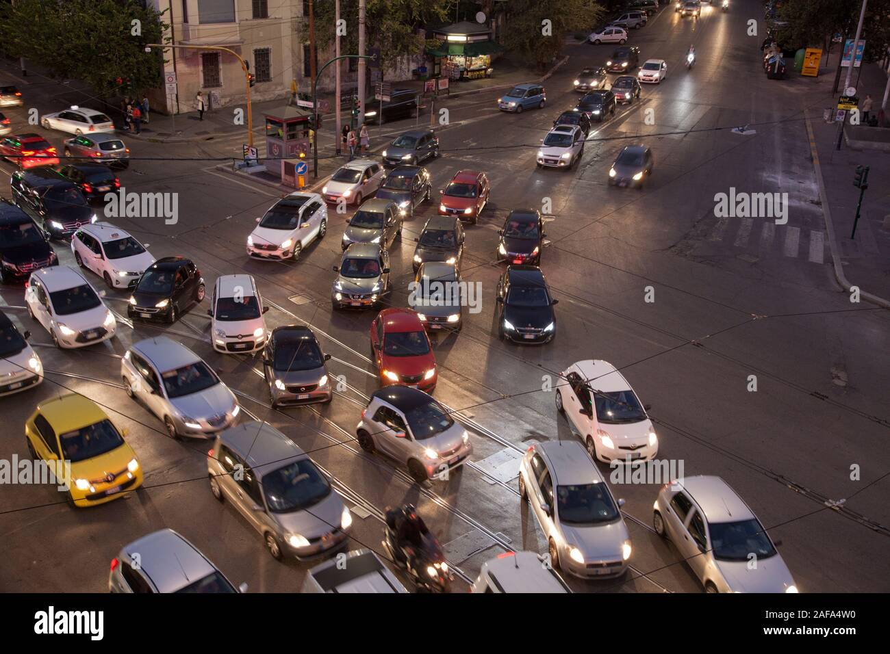
Noise Pollution Impact
Excessive honking causes hearing damage
Increases stress and anxiety levels
Affects public health and well-being
Disturbs residents near traffic signals

Slide 4
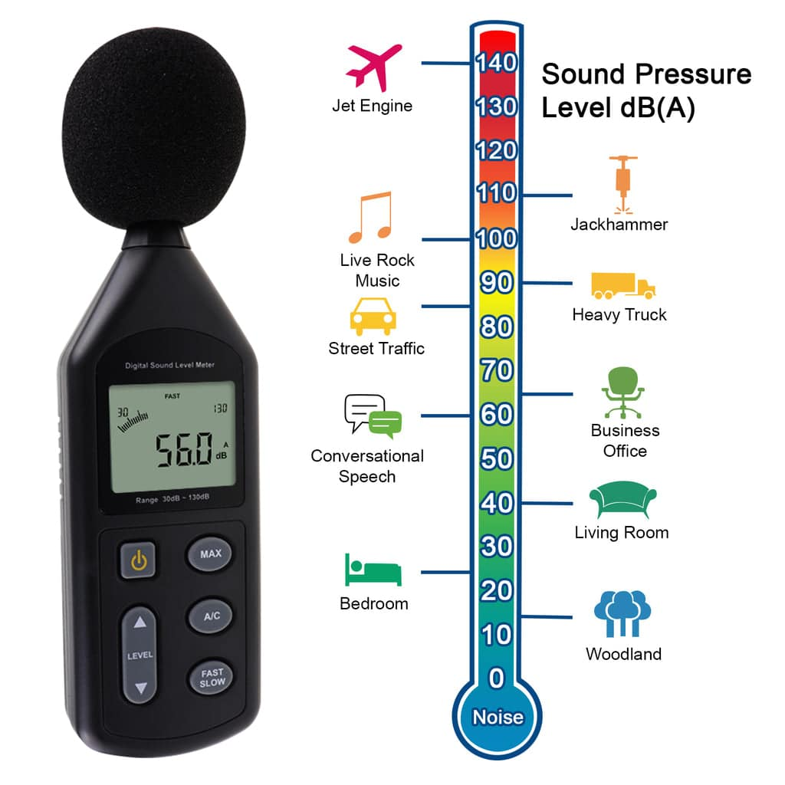
Decibel Meter Implementation
Real-time noise level monitoring
Digital display showing current dB levels
Automatic alert system for threshold breach
Weather-resistant installation

Slide 5
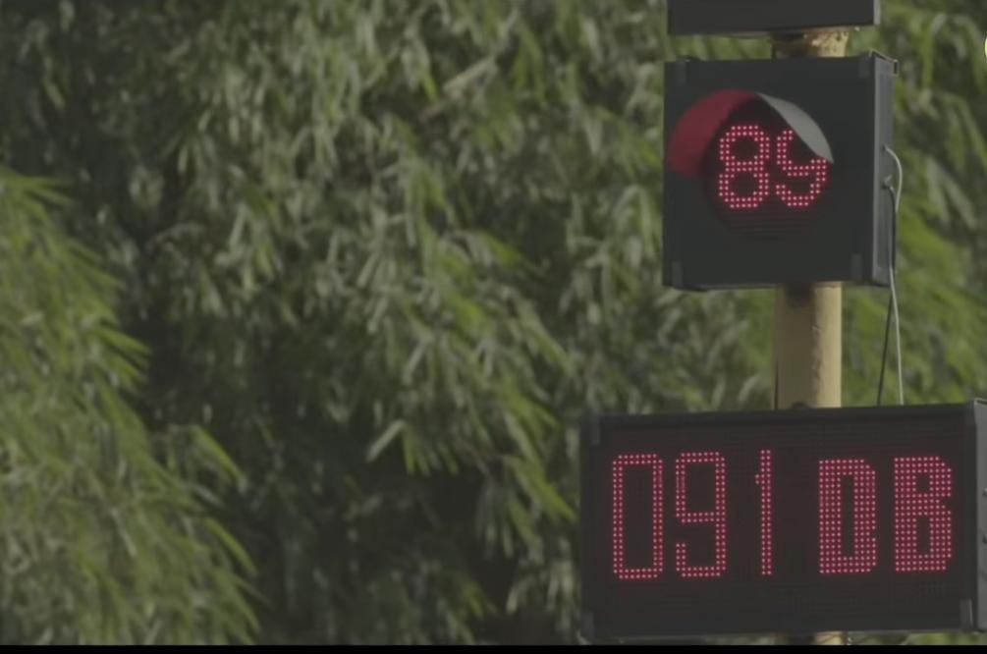
System Mechanism
Set maximum noise limit (e.g., 91 dB)
When limit exceeded → countdown resets
Signal restarts from beginning automatically
Encourages drivers to maintain silence

Slide 6
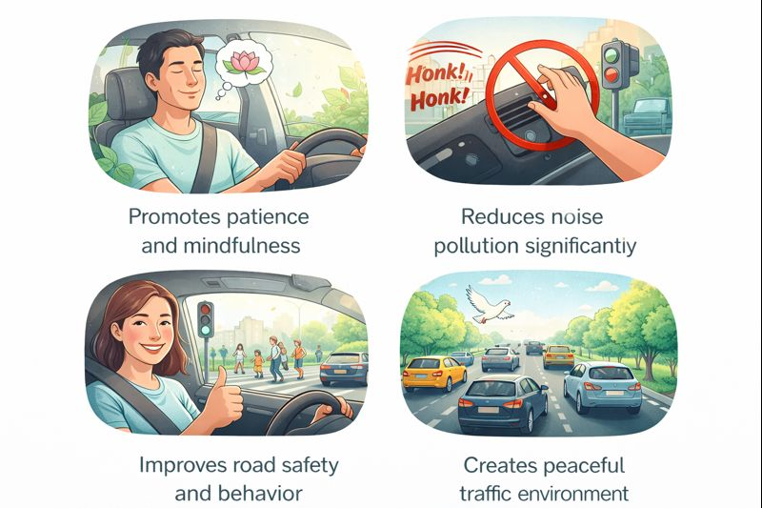
Key Benefits
Promotes patience and mindfulness
Reduces noise pollution significantly
Improves road safety and behavior
Creates peaceful traffic environment

Slide 7
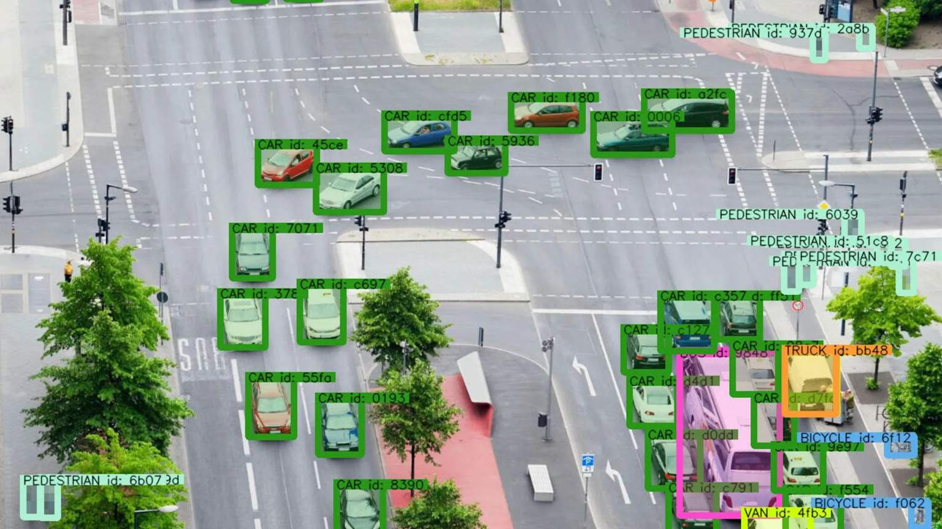
Rollout Plan
Phase 1: Install at high-traffic intersections
Phase 2: Expand to secondary roads
Phase 3: Integrate with traffic management system
Continuous monitoring and optimization

Slide 8
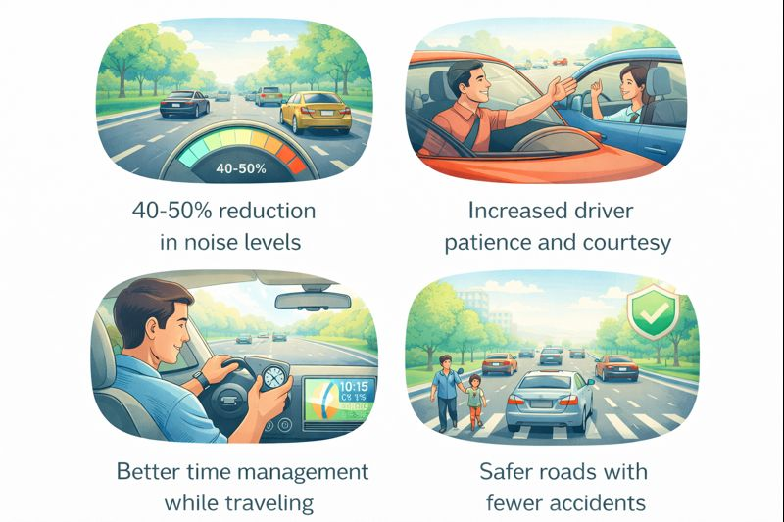
Expected Outcomes

Slide 9
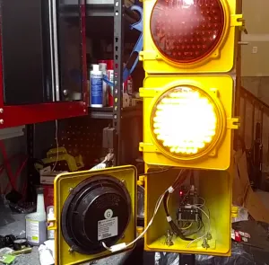
Our Solution….
Install a Decibel Meter at Every Traffic Signal

Slide 10
Conclusion
Patience is the Key to Safe Travel
Together, we can create quieter, safer, and more peaceful roads for everyone.

Slide 11
Provide links to your:
GitHub Public Repository:https://github.com/GKIRANSANTHOSH
MVP Link: traffic%20signal/intel.html

Slide 12

Thank you!

